Slide 1
Simple simulations and not so simple simulations
Kelly Brock
Takeda Fall Group Meeting 12/4/2015

Slide 2
Today’s topics
Setting up molecular dynamics simulations
  Want to calculate change in free energy for mutated residues
CIN simulations – state machine model

Slide 3
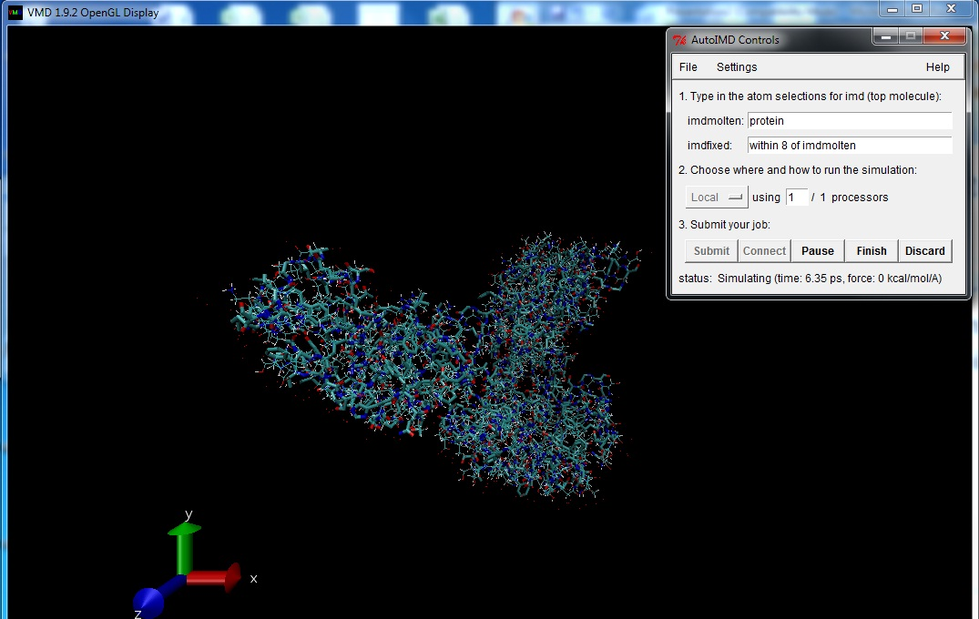
How to simulate molecular dynamics
IT’S ALIVE
Running now
Able to input mutations
Notes:
Note: make sure you set working directory to BarnaseMD at beginning!

Slide 4
Technical details
Using NAMD and VMD
  Windows binary, NAMD 2.9 Win32 Multicore
  VMD 1.9.2 (without CUDA)
Extensions used
  AutoPSF
  Mutator
  Analyze FEP (?)
TO DO:
  Figure out file dependencies
  Error: can’t delete file
  Better understand Mutator interaction with FEP

Slide 5
Simulating tetraploidy jumps to explain bimodality
m1
m2
m3
. . .
2N-1
2N
2N+1
2N+2
4N
ki

Slide 6
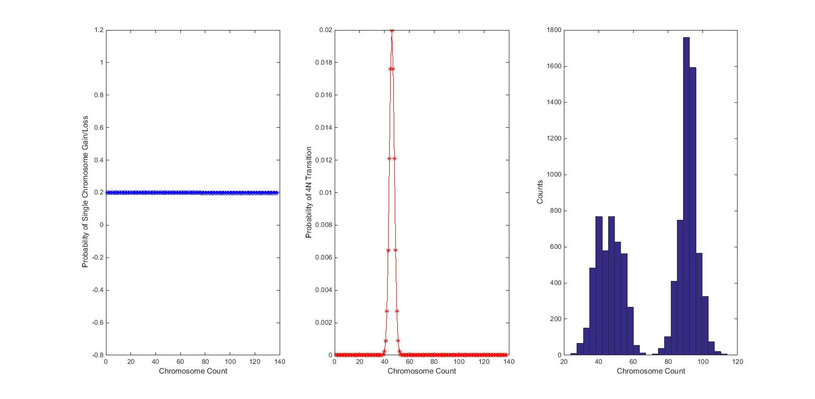
Test 1

Slide 7
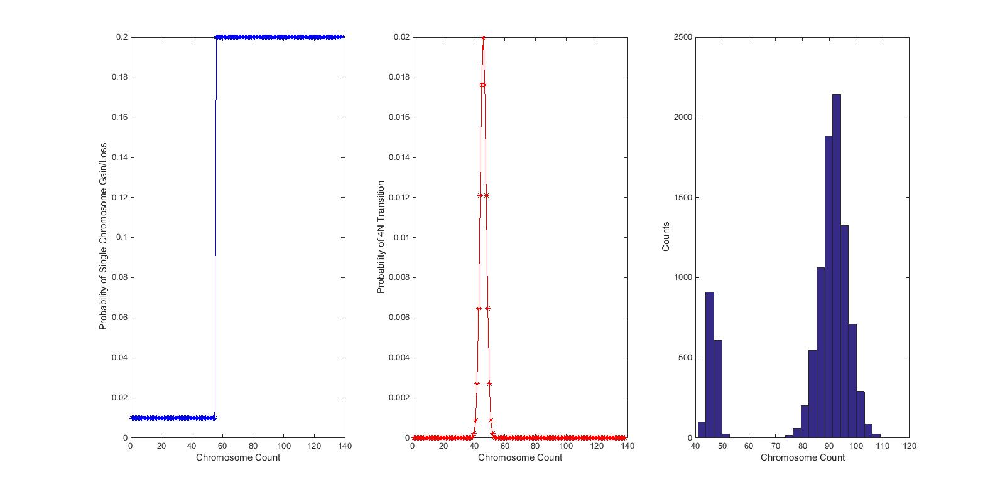
Test 2

Slide 8
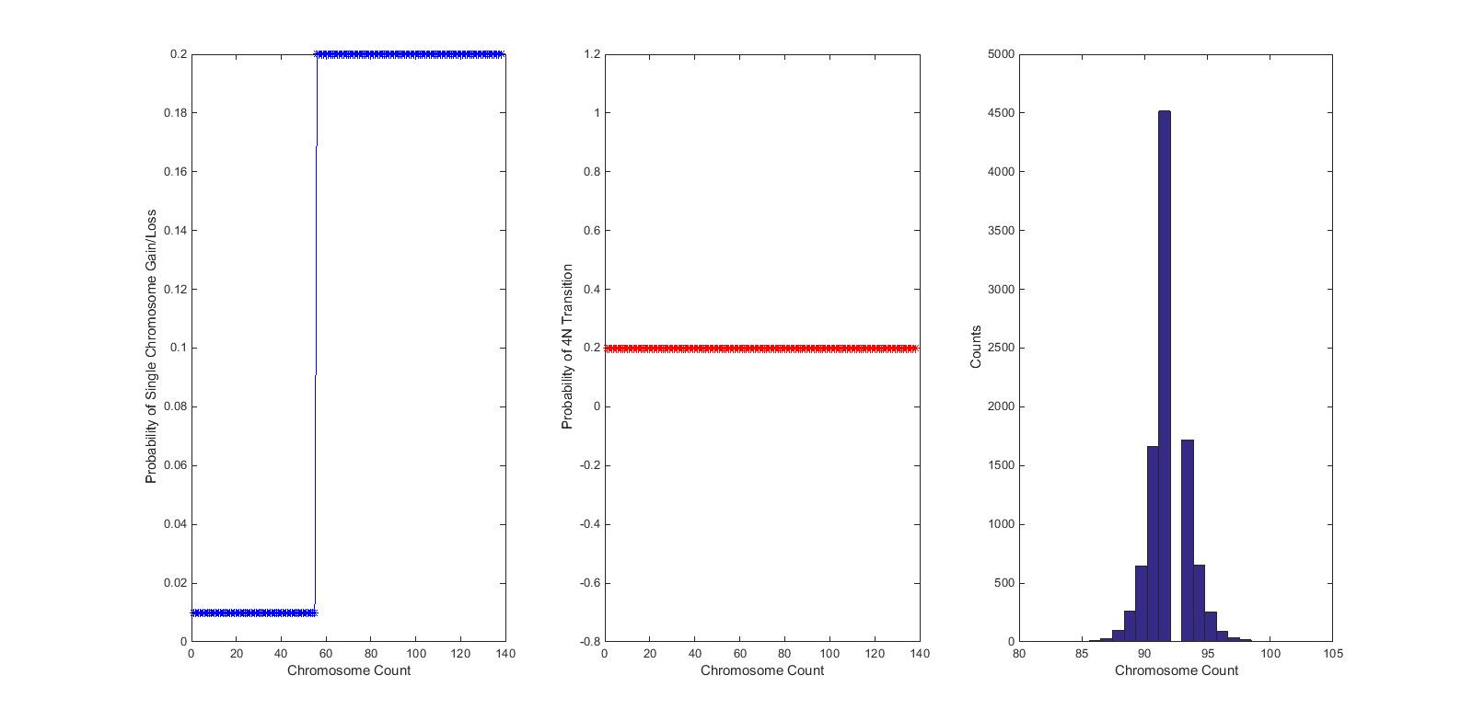
Test 3

Slide 9
To Do List
Get MD to 100% functionality
  Get time on Amazon cluster?
Do maximum-likelihood to get parameters for CIN state machine modeling

